Slide 1
Using Data to Build Member Programs & Services
Saturday February 10, 2018, - 9:45 a.m. - 11:00 a.m.

Slide 2
Session Overview
By using membership satisfaction research, chapter leaders can be better equipped to make data-driven decisions.
Explore who your members are in order to deliver programs and services that will appeal to them.
Notes:
Roland will provide an overview of membership satisfaction research and methods to capture and display the data
Maya will talk about how to use the membership data that is currently at your fingertips to better understand who your members are in order to make informed decisions.

Slide 3
Chapter Membership Research Overview
Qualitative vs. Quantitative
Methodological considerations
Overview of membership satisfaction
Questionnaire design tips
Analytical techniques & post-data collection

Slide 4
Qualitative vs. Quantitative
Broadly speaking, membership satisfaction research can generally utilize either quantitative or qualitative, or a combination of both.
Qualitative and quantitative market research methods each provide different insights into the attitudes and satisfaction.
Notes:
Taken together, these tools provide insight to the overall health of the chapter and steer the direction of chapter programming and services.

Slide 5
Qualitative
Qualitative research gathers a significant amount of data from a relatively small group of respondents. It is not analyzed with inferential statistics.
This approach is commonly used to gain insight into people's intentions and perceptions and, importantly the reasons behind those attitudes.
This methodology allows for the deeper exploration of their opinions on a few topics than is generally possible through a quantitative methodology.
Notes:
Taken together, these tools provide insight to the overall health of the chapter and steer the direction of chapter programming and services.

Slide 6
Quantitative
Quantitative market research follows a systematic approach to collect and analyze information.
The information is gathered in carefully structured ways and is analyzed with inferential statistics.
Notes:
Taken together, these tools provide insight to the overall health of the chapter and steer the direction of chapter programming and services.

Slide 7
Methodological Considerations
Research supplier (third party) vs. in-house
Online / paper
Timeframe / field window
Membership survey (April/May)
Chapter Leader/Board survey (December/January)
Event specific (online / paper)
Incentives (prize draw)
Quality or goodness of sample

Slide 8
What is membership satisfaction and how do you measure it?

Slide 9
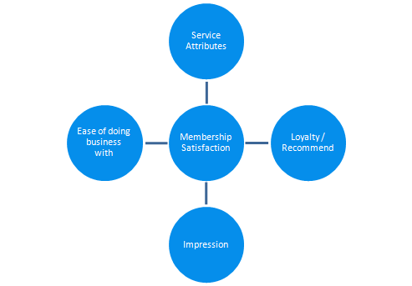
Membership Satisfaction
An important step is to determine how you will measure your chapter’s overall satisfaction. This involves identifying the core measures (key performance indicators) you want to gather data for.
Depending on the chapter’s activities, KPI could be some of the following:

Slide 10
What are the right questions to ask?

Slide 11
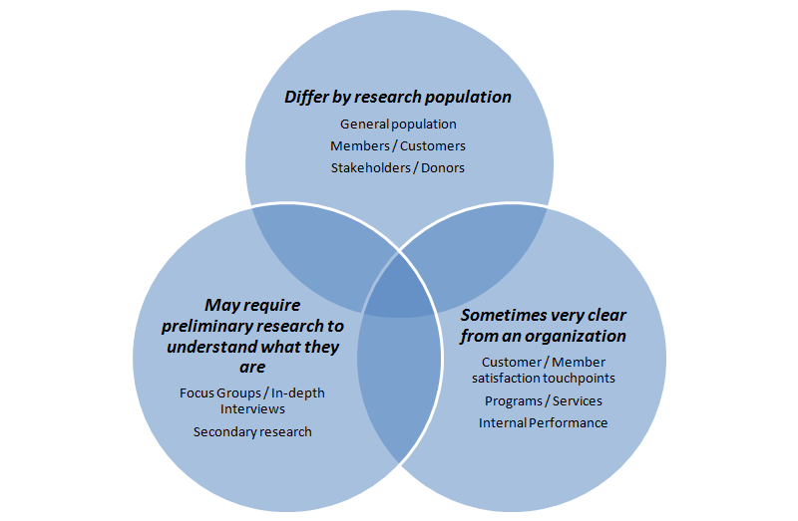
Develop variables to understand membership satisfaction
To understand how your membership perceives your chapter, we must ask the right questions about the right things
But…
What are these?

Slide 12
Examples for testing satisfaction
Once indicators are established, the next step is to to determine the variables or measures that will provide an understanding of what the organization is made of.

Slide 13
Data Collection

Slide 14
Data Collection
Several ways to collect data. The method selected is often determined by a combination of factors including who the research population is and the format of the sample.
Other factors include cost and time.

Slide 15
Data Collection
Telephone
Still the most representative.
Online/Email
Online sample is the most popular for chapters. It can be more affordable than telephone but in some circumstances less representative.

Slide 16
Questionnaire Design Tips

Slide 17
Questionnaire Design Tips
Membership Survey
Length (10-15 minutes max)
Survey incentive (prize draw)
Limiting the number of open-ended questions (less means more)
Flow of questions (demographics towards the end of the survey)
Field Window (1-2 weeks)

Slide 18
Questionnaire Design Tips
Chapter Leader/Board Survey
Length (10-15 minutes max, 20-22 questions including demos, 2-3 open-ends)
No incentive required
Use caution on the number of open-ended questions, especially on repetition
Flow of questions (tougher questions towards the end of the survey)
Field window (1-2 weeks)

Slide 19
Questionnaire Design Tips
Lapsed Member Survey
Length (5 minutes max - 5-10 questions including demos)
No incentive required
Use caution on the number of open-ended questions, especially on repetition - recommend 1
Flow of questions (tougher questions towards the end of the survey)
Field window (1-2 weeks)

Slide 20
Analytical Techniques

Slide 21
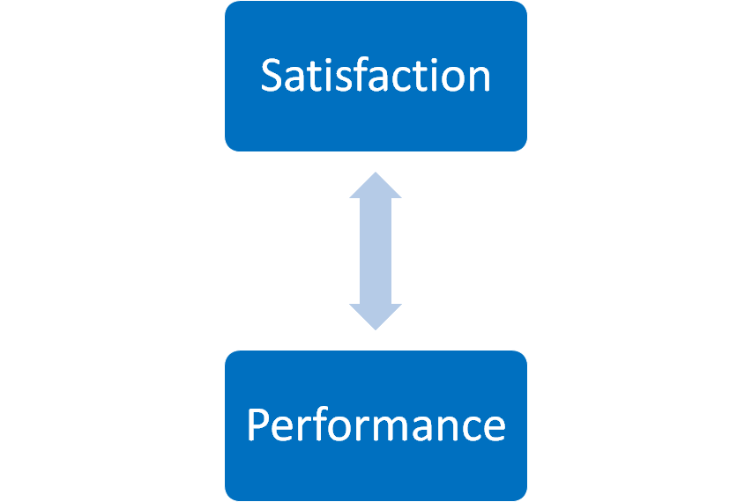
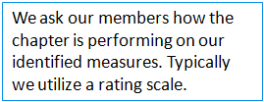
Analytical Techniques

Slide 22
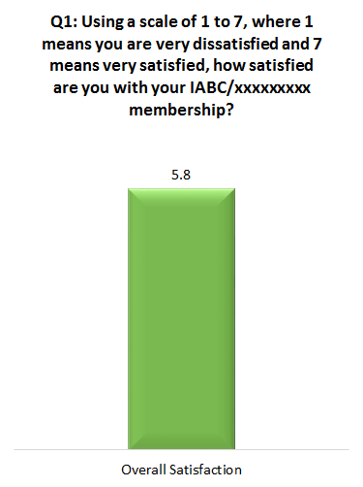
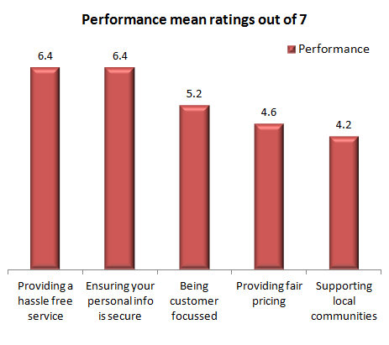
Analytical Techniques
From the above, a chapter can begin to understand how it is performing on measures where it is interacting with their members.

Slide 23
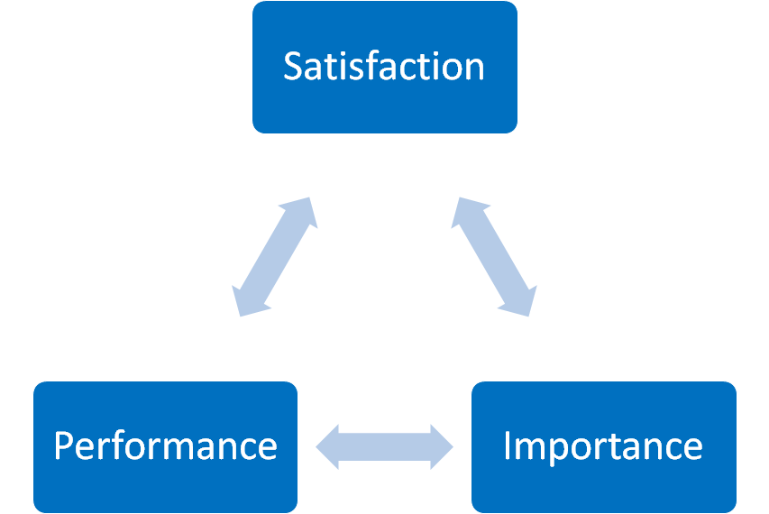
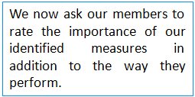
Analytical Techniques

Slide 24
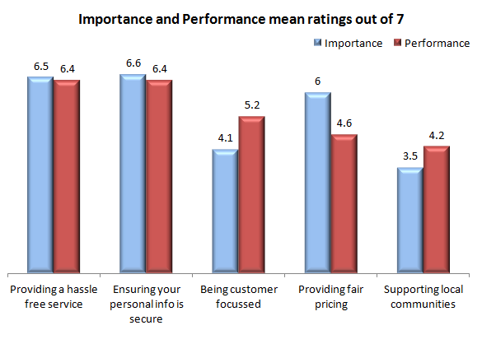
Analytical Techniques
Now, a chapter can understand its performance in relation to importance on the organizational measures among chapter members.

Slide 25
Post-Data Collection

Slide 26
Post-data collection
Produce a report
Discuss results with the board
Make data-driven decisions

Slide 27
Using Your Membership Data

Slide 28
MMA
MMA has some drawbacks
Take your data with a grain of salt
Still has valuable info you can pull
Notes:
MMA doesn’t have the best information - we have all been hopeful that the new membership database will be a major improvement
People don’t update their MMA information regularly, so some of it may be outdated, or missing information
However, you can still pull some useful data out of MMA, and we’ll hopefully be able to do even more with our data soon

Slide 29
What can you find in MMA?
Types of members
Accreditation/certification
Lapsed members/members who decided not to renew
Type of organization they belong to
Notes:
Types of members - one thing on MMA that will always be accurate! That’s your Professional, Corporate, Student, Transitional and 500 Club
Another accurate piece of information: whether they have an ABC or CMP
You can see who is lapsing soon, who has lapsed recently, or who has chosen not to continue with their membership
Type of organization they belong to: one thing to take with a grain of salt, as they might not have updated this upon joining or last renewing, or there could be blank info. But we have found that the rough percentages found here are indicative of our chapter.

Slide 30
What can I do with this data?
Strategic planning/introduction to board members
Use as a basis for all planning going forward
Notes:
IABC Edmonton reviews our data in time for our strat planning session, and provides an overview/update of where our membership currently sits and who our membership is to returning and new board members - I’ll show you examples of the type of information we pulled out last year
You should have a good idea of who your members are, and that, combined with data gathered from your survey, should help you plan programming and content that will appeal to your members

Slide 31
IABC Edmonton’s Data

Slide 32
Growing Number of Members
2016 | 2017
483 | 523
3rd largest chapter in the world! | 2nd largest chapter in the world!
Notes:
Information as of June 2017

Slide 33
Type | 2016 | 2017 | Change
Professional | 217 (45%) | 231 (45%) | nil
Corporate | 193 (40%) | 192 (38%) | - 2%
Student | 47 (10%) | 56 (11%) | + 1%
Recent Grad/Transitional | 13 (2.5%) | 18 (4%) | + 1/5%
500 Club | 12 (2.5%) | 12 (2%) | - 0.5%
Retired | 1 | 2 | + 1
ABC | 17 | 17 | nil
Notes:
Professional: 45% - 217
Corporate: 40% - 193
Student: 10% - 47
Transitional/Recent Grad: 2.5% - 13
500 Club: 2.5% - 12
Retired: 1

Slide 34
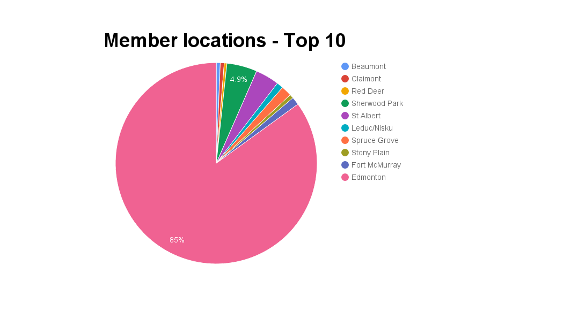
Notes:
Most members live/work out of Edmonton but we have members as far as Fort McMurray
Something to consider as not all members can make it out to our events
What else can we do for these members?

Slide 35
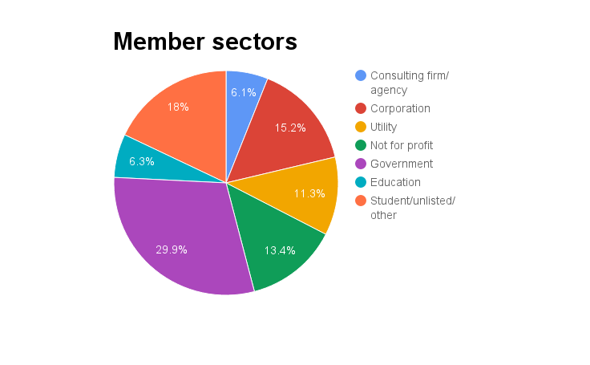
33 members are self-employed
Notes:
Government: 30% - 143
Student/unlisted/other: 18% - 86
Corporation: 15% - 73
Not for profit: 13% - 64
Utility: 11% - 54
Consulting firm/agency: 6% - 29
Education: 6% - 30

Slide 36
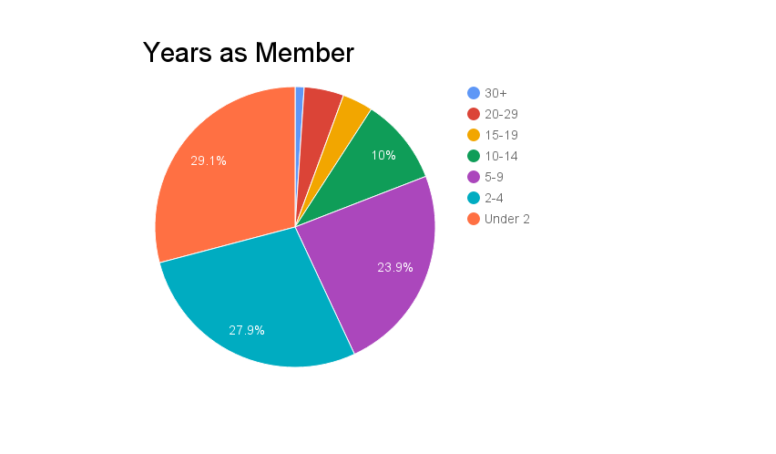
Notes:
30+: 5
20-29: 22
15-19: 17
10-14: 48
5-9: 115
2-4: 134
Under 2: 140
This is the closest info we have to tell us how many years our members have been in the industry as we don’t have accurate stats about that from International

Slide 37
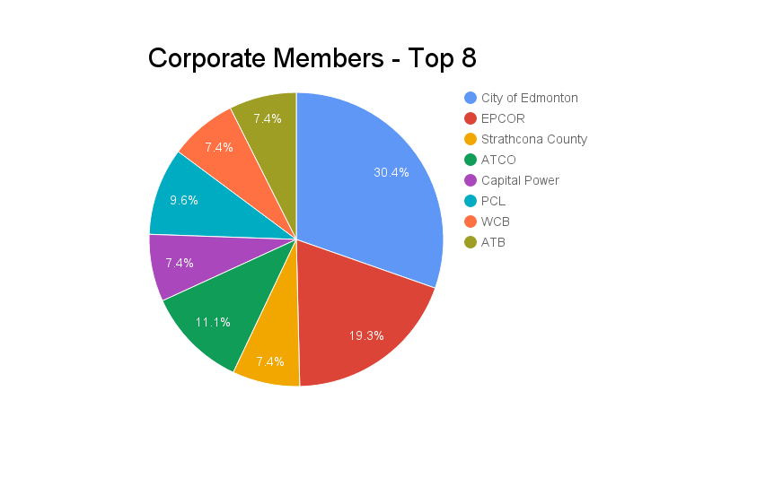
Notes:
Out of 193 corporate members:
City of Edmonton: 29% - 41
EPCOR: 18% - 26
ATCO: 10% - 15
PCL: 9% - 13
Strathcona County: 10
Capital Power: 10
WCB: 10
ATB 10

Slide 38
Overall retention rate
Retention rate: ~66.67%
Attrition rate (lost members): ~33.33%
Compare to IABC (as a whole)
Retention rate: ~56%
Average membership years: 6.1
Notes:
Retention rate is the metric that shows the proportion of members that have stayed with us for a while.
Any marketing professional will tell you that customer retention is better than customer acquisition. It requires less effort and is less expensive.
With a great retention rate, you’re better able to generate revenue and get new members organically
By measuring retention rate, you can benchmark your performance and identify areas where you can increase customer retention.
Our membership in Edmonton has grown over the years not because we’re gaining new members. Think of where our chapter could be if we were focused on retaining members too.
Acquisition focuses on the short-term, whereas retention focuses on the long-term relationship

Slide 39
Retention rate formula
Member retention rate = ((ME-MN/MS)) x 100
ME = # of members at end of period
MN = # of new members acquired during period
MS = # of members at start of period
Notes:
Best to look at the retention rate annually to compare.
To initially benchmark it, I used a period of 3 years.

Slide 40
Who’s our most vulnerable member?
Of members who left: 46.3% left after one year
67% of those are professional members
Notes:
We can target these members at events
Should focus on retaining these members out of all of them

Slide 41
Using the Information

Slide 42
Using this info for programming
Locations of members
Sectors
Corporate membership
Years as member
Notes:
Location of members: if you have a lot of members in surrounding/towns cities - are you using webinars or even taking events through them? If not, you might be leaving out a large group of people from your programming, and they might be questioning the value
Sectors: if you have a large number of government members, consider PD sessions that cater to content they would be most interested in
Corporate membership: as you saw, 40% of IABC Edmonton’s membership is corporate - but what are they getting aside from a small discount on their dues? One thing we haven’t yet done in Edmonton but has been on my radar for a while, is offering specific programming for our largest corporate members. For example, the City of Edmonton has 41 corporate members. We could easily go in and deliver a PD session just for this group, focused on a topic applicable to their industry. That would help retain them as a corporate member, and potentially entice more people to join.
Years as a member is the best way (right now) to gauge years of experience. This is with a caveat that it won’t be 100% accurate, but out of the data we have, it’s the best tool available. I am hoping the new membership database will give us more accurate information for how long someone has been in the profession. I think this will be grouped by the career road map. By looking at years as a member, we can very clearly see who our more senior members are. When you’re looking at people who have been members for less than 5 years, we can assume those people are relatively newer to the field. There would be instances where seasoned communicators are joining for the first time, but that is typically an anomaly. By looking at these numbers, we know how much of our programming we should target towards people at the different stages of their careers.

Slide 43
Using this info for programming
Retention rate
Vulnerable member
Notes:
Retention rate: if you find your retention rate is very low, you might want to consider putting more of a focus on member retention programming and campaigns, rather than trying to attract new members - it is easier to keep a member than to convert a new one
Once you know who your vulnerable member is (remember, Edmonton’s was new professional members) then you can devote more energy to that group. For example, do more regular check-ins with them to ensure they are getting what they need from their membership (personal phone calls go a long way), figure out who is attending your events. If there are new professional members who have been with IABC less than a year - get a board member or two to make it their mission to talk to that person and check-in on how their membership is going

Slide 44
Tips
Find a numbers person on your board
Consider creating a new position
Notes:
It’s not that common in communications, but there are some of us who actually enjoy numbers and data. If you have someone like that on your board, even if there board position isn’t related to membership, USE THEM!
IABC Edmonton created a board position last year called our Director of Member Research

Slide 45
Director of Member Research
Collects historical data
Data pulled monthly: active members, recent renewals, lapsing soon and recent joins
Data for events: guest list compared to active members list
Six month follow-up
Data as requested by board members
Notes:
Main goal of the position is to collect historical data so that we can predict any trends
First of the month, data pulled, including: active members, Recent Renewals, Lapsing soon, Recently Lapsed and Recent Joins.
In the new board term there will be data to compare during members month or back-to-school. It might even indicate when the best times are for membership promotions, so that resources are used efficiently, and strategically.
For networking or PD events, the guest list is pulled from Eventbrite and compared with the active members list. Key member stats -member level, anniversaries, new member - are then passed on to programming and events. This allows Board Members to target members in the crowd. Plus, build capacity within the membership.
Six Month follow-up: The active members list is updated to show all members that need a six month follow-up. Done via email. This keep members connected, and feel valued - more incentive for getting involved. The follow-up also provide a point of contact that members can direct questions, and general feedback. The Follow-up is a personal email, not a email/newsletter service.
Provide data when requested: 30 member count, 60 days count, checking if volunteers joined, mentees joined.

Slide 46
Director of Member Research
Collects historical data
Data pulled monthly: active members, recent renewals, lapsing soon and recent joins
Data for events: guest list compared to active members list
Six month follow-up
Data as requested by board members
Notes:
Main goal of the position is to collect historical data so that we can predict any trends
First of the month, data pulled, including: active members, Recent Renewals, Lapsing soon, Recently Lapsed and Recent Joins.
In the new board term there will be data to compare during members month or back-to-school. It might even indicate when the best times are for membership promotions, so that resources are used efficiently, and strategically.
For networking or PD events, the guest list is pulled from Eventbrite and compared with the active members list. Key member stats -member level, anniversaries, new member - are then passed on to programming and events. This allows Board Members to target members in the crowd. Plus, build capacity within the membership.
Six Month follow-up: The active members list is updated to show all members that need a six month follow-up. Done via email. This keep members connected, and feel valued - more incentive for getting involved. The follow-up also provide a point of contact that members can direct questions, and general feedback. The Follow-up is a personal email, not a email/newsletter service.
Provide data when requested: 30 member count, 60 days count, checking if volunteers joined, mentees joined.

Slide 47
Questions?

